Slide 1
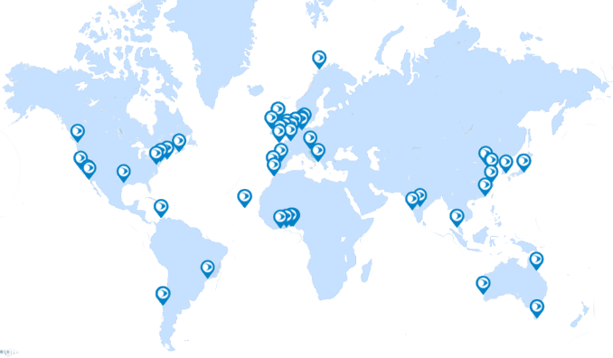
NF-POGO Miniboats:
Outreach onboard the
2022 North-South Atlantic Training Transect (NoSoAT)

Slide 2
WhAT is POGO?
Background

Slide 3
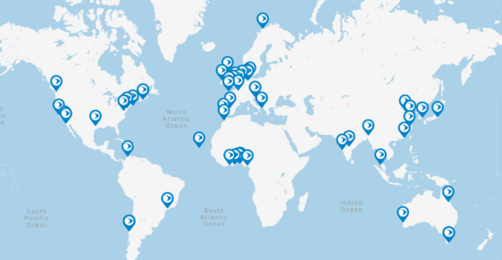
: a snapshot
Created in 1999, POGO is an international consortium of major oceanographic institutes, represented by their Directors.
55 members
Innovation in ocean observing
Capacity development
Outreach
& advocacy
29 countries
Embracing & funding new technologies
Training the next generation of ocean scientists
Explaining the importance of ocean observing to non-specialists
6 continents
Activities:
Workshops
Seed funding for innovative projects & working groups
Partnering with other key ocean organisations
Activities:
Shipboard fellowships
Regional training in developing countries
Fellowships for training at top institutions
Activities:
Participation in high-level events (COP, GEO)
Statements & briefings pitched at policy makers
Public outreach & ocean literacy
POGO’s goal: World-wide cooperation for a sustainable, state-of-the-art global ocean observing system that serves the needs of science and society.
To achieve its goal, POGO focuses on 3 pillars:
www.pogo-ocean.org
pogoadmin@pml.ac.uk
POGO_Ocean
POGO.Ocean
pogo_ocean

Slide 4
Shipboard TRAINING & OUTREACH
Introducing the project

Slide 5
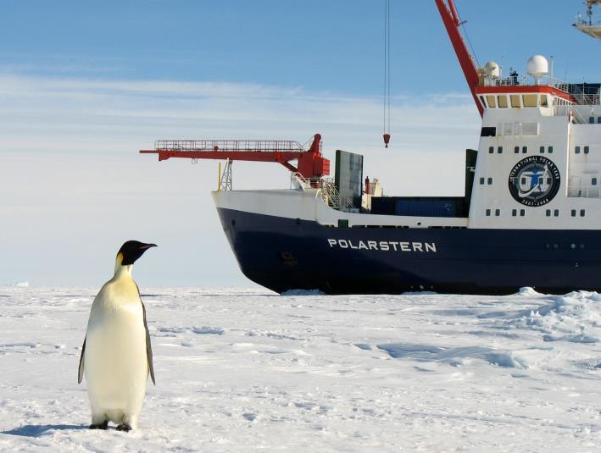
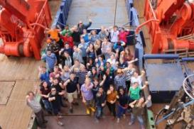
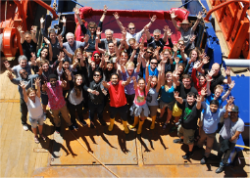
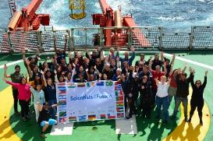
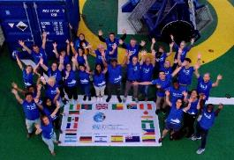
NoSoAT/SoNoAT Floating Summer Schools
NoSoAT-2015
NoSoAT-2016
SoNoAT-2019
NoSoAT-2022
©Alfred Wegener Institute (AWI)
Notes:
Since 2015, the Nippon Foundation and POGO have supported the Alfred Wegener Institute’s dedicated training cruises on ‘empty legs’ between ports, ie when the RV Polarstern is on her way to or from AWI’s Antarctic station, without a research team on board.
These were the North-South or South-North Atlantic Training Transects in 2015, 2016 and 2019, and this year’s transect – 2022.

Slide 6
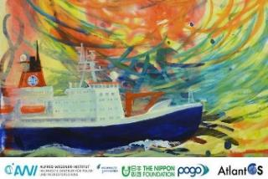
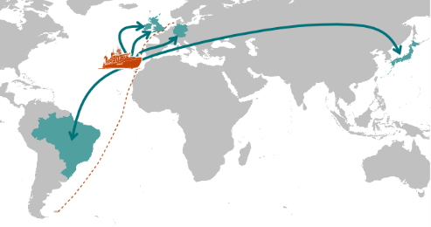
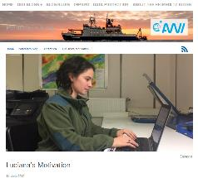
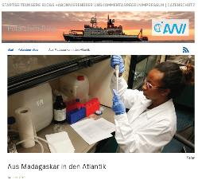
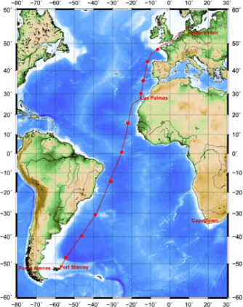
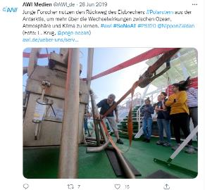
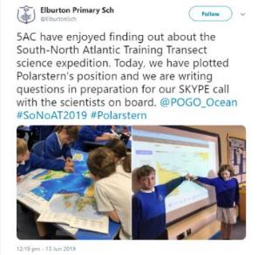
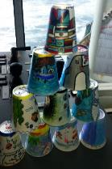
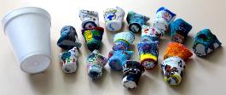
2019 SoNoAT Outreach
NoSoAT16 Artwork
Blog posts
Engagement of schools pre-cruise
Skype with 15 schools in 5 countries
Social media
“Shrunken Cup” design
©Alfred Wegener Institute (AWI)
Notes:
AWI first piloted shipboard outreach & ocean literacy during the 2016 cruise. And during the 2019 SoNoAT we were able to expand this into a major international initiative.
Conducted in June 2019, from the Falkland islands to Bremerhaven, the 23 early career scientists training on board engaged school children in marine science through:
Skype calls with the ship,
sending Live data from the ship so the children could plot on a map and
a ‘Shrunken Cup’ design competition to demonstrate deep ocean pressure.
The SoNoAT outreach was very successful and engaged over 250 children in Germany, Ireland, UK, Brazil and Japan. We think we have a good opportunity to repeat the success with the 2022 NoSoAT

Slide 7
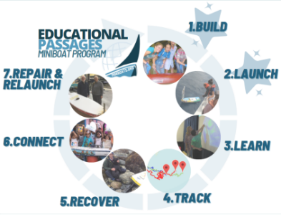
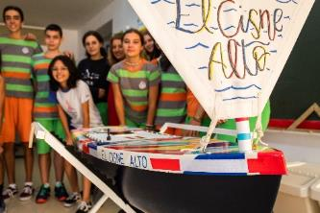
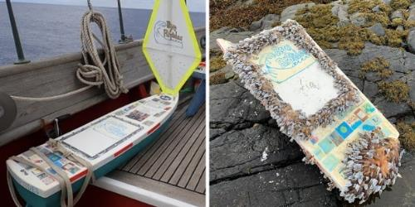
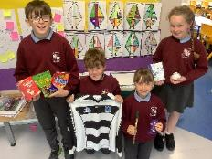
Miniboats
Educational Passages (EP)
1.5m un-crewed sailboat
Satellite transmitter
Sensors for air and sea surface temperature
Assembled by school children
Track and learn
Once landed, can be repaired and relaunched
Modern “message in a bottle”
Colegio Cisneros Alter
Rye Jr. High School
Lackagh NS
Notes:
For the 2022 cruise, POGO, with the financial support of the Nippon Foundation, has purchased four ‘Miniboats’ from Educational Passages – a not-for-profit organisation. These are 1.5m long uncrewed vessels, which each have a satellite transmitter, allowing them to be tracked as they sail across the ocean, together with sensors for air and water surface temperature. They are supplied as a ‘build-your-own’ kit, designed to be assembled and decorated by school students as part of a guided project.

Slide 8
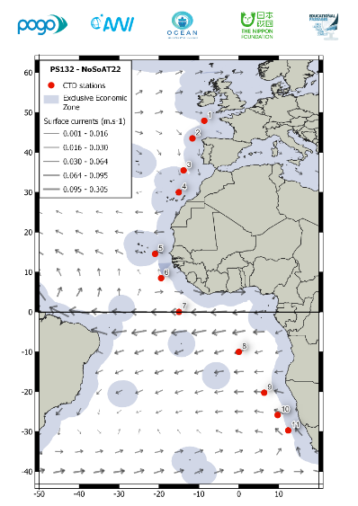
NF-POGO Miniboats
POGO has purchased 4 Miniboats
With assistance from EP and POGO partners in Ireland, Germany, Spain and South Africa:
Assembled by local schools: ~25 students (≥10 y.o.) separated into 6 teams (1h/week, 8 weeks)
Delivered to RV Polarstern
Deployed during the NoSoAT transect at the onboard science team & Captain’s discretion
South African to be deployed in another cruise
Notes:
We are partnering with oceanographic institutions in Ireland, Germany, Spain and South Africa, who are each working with local children to assemble the miniboats. These will then be deployed in the Atlantic, allowing the students to track the progress of their own vessel, and that of the others involved in the project, and learn about ocean currents, weather, technology, etc. The international collaborative nature of the project provides an extraordinary opportunity for school children in four different countries to interact with each other, their local oceanographic institution and researchers and with the young marine science trainees on board the ship.

Slide 9
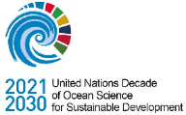
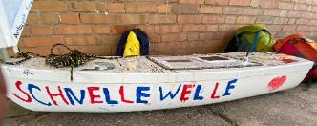
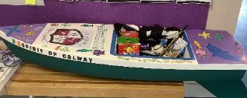
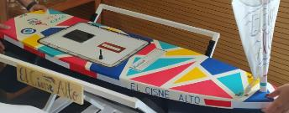
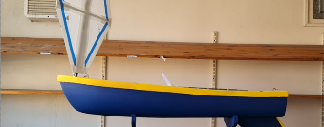
Participants
Sophie Seeyave
Fiona Beckman
Lilian (Lica) Krug
Karen Wiltshire
Eva-Maria Brodte
Bärbel Wichmann
Programme endorsed
Cassie Stymiest
Germany
Ireland
Spain
South Africa
Alfred Wegener Institute
Eva-Maria Brodte
Bärbel Wichmann
National University of Ireland
Sheena Fennell
Peter Croot
Spanish Institute of Oceanography
Jesús Arrieta
South African Environmental Observation Network
Thomas Mtontsi
School: Ferienfreizeit-Aktion, Helgoland
School: Scoil Bhríde, Lackagh
School: Colegio Cisneros Alter
School: Luhlaza High
Eva, Bärbel, Max & POGOnians
Mr Shane O Connor
Mr Tomas Higgins
Ms Violeta Goñi Alvarez
Ms. Unathi Booi
Ms Elizabeth Nxele
Mr. Cingca
Schnelle Welle
(Fast Wave)
Spiorad na Gaillimhe
(Spirit of Galway)
El Cisne Alto
(The Tall Swan)
Yemaya
Notes:
The German Icebreaker departed from Bremerhaven on 30 Aug, and is carrying three of our miniboats, to be deployed during September:
The El Cisne Alto (The Tall Swan), assembled by students of Colegio Cisneros Alter, with the support of Dr Jesus Arrieta from the Spanish Institute of Oceanography in Tenerife, Spain.
The Schnelle Welle (Fast Wave), assembled by children participating in a summer activity camp, with the support of Dr Eva-Maria Brodte from the Alfred Wegener Institute in Helgoland, Germany
The Spiorad na Gaillimhe (Spirit of Galway), assembled by students of Scoil Bhríde Lackagh, with the support of Dr Sheena Fennell from the National University of Ireland in Galway, Ireland.
The fourth miniboat (Yemaya), assembled by students of the Luhlaza High, with the support of Dr Thomas Mtontsi from the South African Environmental Observation Network in Cape Town, will be deployed by the South African Department of Forestry, Fisheries and the Environment’s Research Vessel Algoa, around the 27 September.

Slide 10
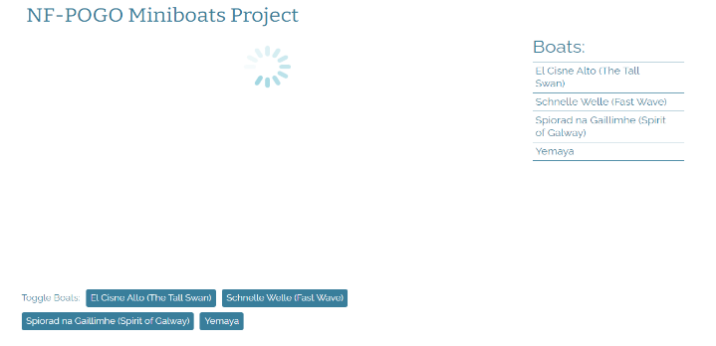
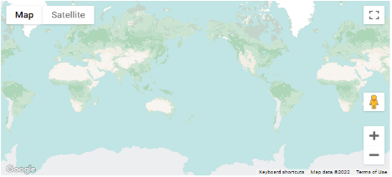
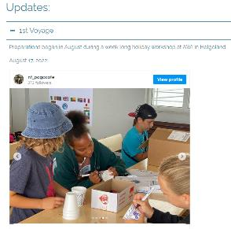
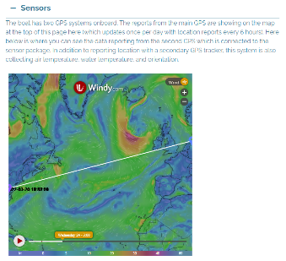
Educational Passages
https://educationalpassages.org/events/pogo/
EP Website
Project page
Summary
Tracking of 4 vessels
Miniboat page
Tracking of individual vessels
Share stories & updates
Sensor data (air & water temperature) at the bottom

Slide 11
Why & How do we observe the ocean?
Ocean Literacy

Slide 12
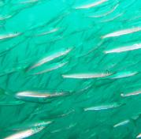
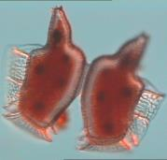
Some Facts and Figures about the Ocean
The ocean covers 70% of the surface of the Earth
The ocean represents over 90% of the Earth’s biosphere
Phytoplankton in the ocean produce as much oxygen as land plants
Notes:
It is often said that we know more about the dark side of the Moon than we do about the ocean. However, the ocean plays a vital role for us all.
3 key examples are:
(1) the ocean covers more than 70% of the surface of the Earth;
(2) the ocean represents more than 90% of the Earth’s biosphere (the space in which living organisms can exist);
(3) perhaps the least well known but most important element, microscopic plants (phytoplankton) in the ocean produce as much oxygen globally as land plants, providing half the oxygen we breathe.

Slide 13
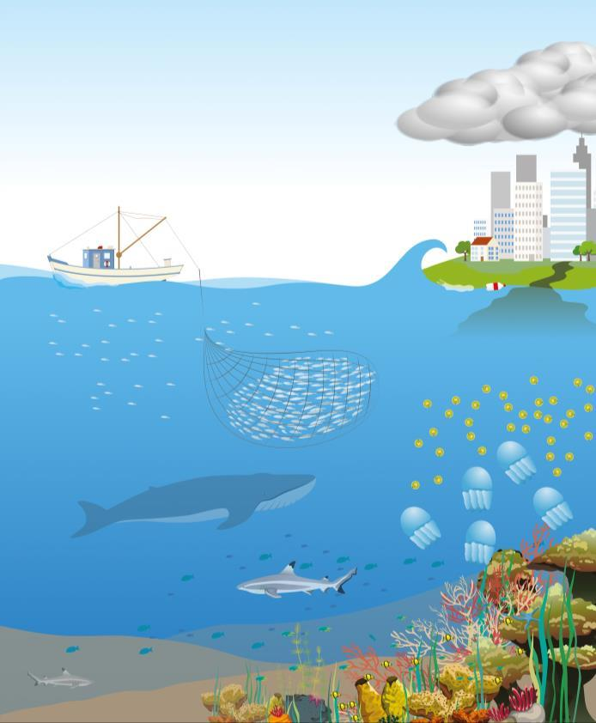
WHY do we need to observe the ocean?
Predict the weather
Understand the changing climate
Monitor pollution
Use the ocean’s resources responsibly
Monitor blooms
Notes:
Monitoring and exploring the ocean is very important so that we can understand and predict future changes.
Predict weather
People who live by the coast or sail on the ocean can be put in danger by severe storms, flood and droughts. Weather forecasting helps to keep them safe
Understand the changing climate
Climate change will cause rising sea levels, change to weather, changes to plants and animals, and erosion of land
Monitor pollution
Pollution such as plastics, litter, sewage, chemicals and noise can come from land or from ships and boats
Use the ocean’s resources responsibly
We use the ocean for food (fish, shellfish), minerals (metals, oil, salt) and energy (wind, waves)
Monitor blooms
When conditions are right, algae and sea jellies can grow and reproduce rapidly, causing a population explosion or bloom.
Some blooms can be toxic to fish or cause illnesses in humans.

Slide 14
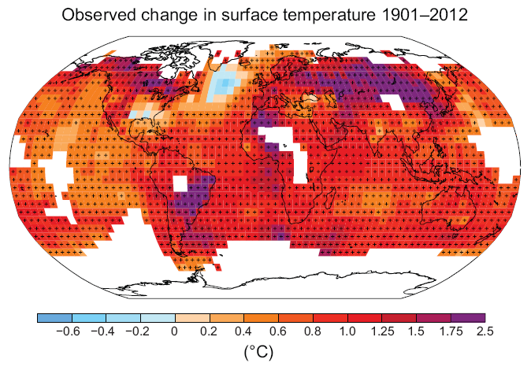
Ocean warming
IPCC, 2013: Summary for Policymakers.
IPCC AR5, Box 3.1 Fig1, Rhein et al. 2013
More than 90% of Earth’s heat increase has been absorbed by the ocean.
Notes:
The figure on the left shows that actually very little of the excess heat produced by CO2 emissions has been retained in the atmosphere or on land.
In fact, 90% of the Earth’s heat increase has been absorbed by the ocean, and this has taken place only in the last few decades.
It is important to note that a lot of the excess heat has already been taken into the deep ocean.
- The changes is ocean temperature (shown on right) are already affecting the global distribution of fish, invertebrates and plankton species.

Slide 15
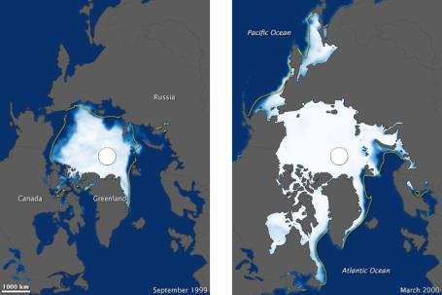
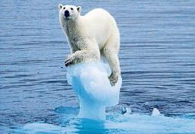
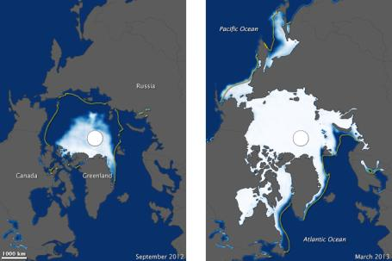
Melting ice
Sept 1999
Mar 2000
Over the last two decades, the Greenland and Antarctic ice sheets have been losing mass, glaciers, Arctic sea ice and snow cover have continued to shrink.
These satellite images show an overall decline in Arctic sea ice, particularly since 1999.
Source: telegraph.co.uk
Sept 2012
Mar 2013
Source: NASA Earth Observatory, http://earthobservatory.nasa.gov
Notes:
- These satellite images from NASA show the Arctic ice cover during summer (on left) and winter (on right),
- There has been an overall decline since 1978, but particularly since the turn of the 21st century.
- We are observing very recent and rapid changes.
Among other impacts, this will affect animals that rely on the ice for their survival.

Slide 16
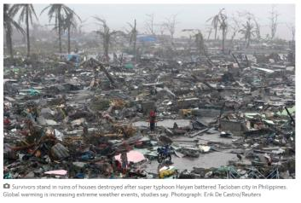
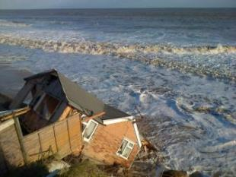
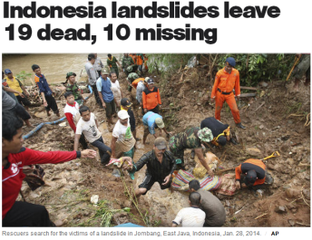
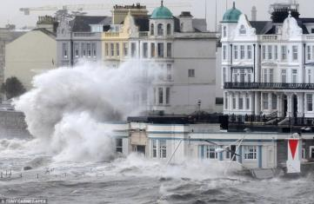
More extreme weather events
UK: Worst storm and tidal surge in 60 years , 2014
Typhoon Haiyan in the Philippines, 2013
Source: theGuardian.com
Source: DailyMail.uk
Notes:
- It is predicted that a rise in extreme weather events will be associated with the higher temperatures and precipitation in future.
Recent examples of this trend include the “super typhoon” Haiyan in the Philippines.
Closer to home there were severe storms/tidal surges in the UK earlier this year that caused flooding, cliff erosion and loss of properties, and destruction of train lines along the coast.
Heavy precipitation is also causing landslides causing major destruction and loss of life (example Indonesia this year).

Slide 17
WHAT do we measure?
Notes:
We measure lots of different properties of the ocean, from the temperature and colour of the water, to the amount of animals living in a particular area.
There are some very technical terms here, but I bet you know some of them.
You could ask the scientists on Polarstern about any you don’t understand.

Slide 18
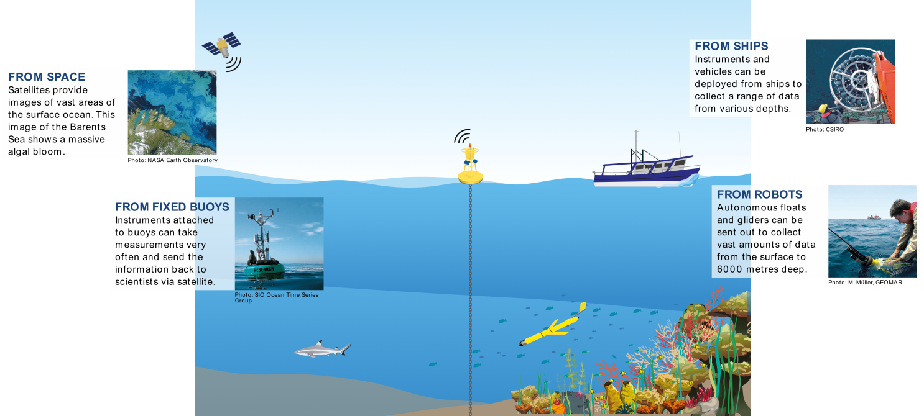
HOW do we observe the ocean?
Notes:
Scientists use different methods and equipment to observe and measure the ocean.
One important way to is to travel across the ocean on a research ship, taking lots of samples and measurements along the way, and trying to understand what the measurements mean.
This is what the NoSoAT project is all about. We will have 13 young marine scientists on board the ship, Polarstern, together with several expert teachers.
These young scientists may seem old to you! They are between 23 and 29 years old, but scientists never stop wanting to learn more about the subjects that interest them, so they are going to school on board the ship!
They come from lots of different countries around the world – mainly Developing Countries, which are places that don’t have as much money for scientific research as countries in Europe or North America They will learn lots about ocean observing while on board the ship, and then take this knowledge back home to their own universities and research institutions.

Slide 19
About Polarstern
Scientific Research Cruises

Slide 20
The Ship: R/V Polarstern
German research ship
An ‘Icebreaker’ that mainly works in the ARCTIC and ANTARCTIC
118 metres long
44 crew + 55 scientists
2 helicopters on board
Notes:
This is the Polarstern, which is the ship the scientists will be travelling on.
R/V stands for Research Vessel.
It takes a crew of 44 people to run the ship.
As well as this, up to 55 scientists and technicians can live and work on board.
The ship has nine science laboratories.
More about the ship:
https://www.awi.de/en/expedition/research-vessel-and-cutter/polarstern.html

Slide 21
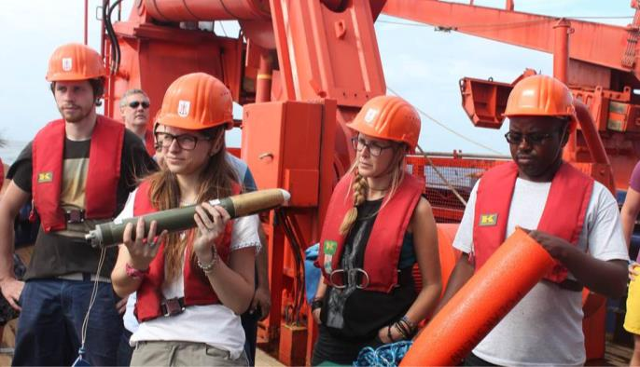
In one month at sea…
Polarstern’s engines and boiler burn 900 tonnes of diesel fuel
The ship’s galley (kitchen) bakes 3,150 rolls
In the mess hall (dining area) 3,200 eggs, 360 litres of milk and 180 litres of fruit juices are consumed
The people on board use 680 rolls of toilet paper
Notes:
Taking a research ship on an ocean expedition costs a lot of money, and takes lots of organising.
Here are just a few of the things the people planning the cruise need to think about.

Slide 22
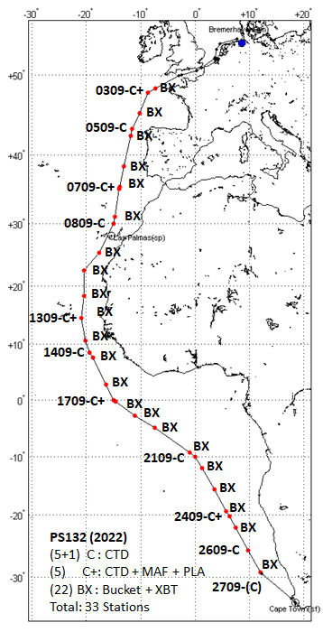
Where will it go?
Leaves:
Bremerhaven, Germany
on 29 August
Travels south
Arrives:
Cape Town, South Africa
on 29 September
Follow Polarstern’s location/activities here:
https://follow-polarstern.awi.de/?lang=en#main-menu
Notes:
This is simple map showing the route the ship will take.
The red dots show CTD sampling stations. These are places where instruments are sent deep into the ocean to collect samples.

Slide 23
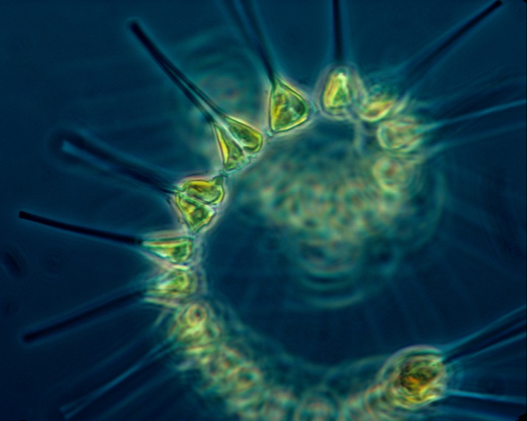
What will they be studying?
Water temperature and other physical properties
Plastics and micro-plastics
Phytoplankton (tiny floating plants)
eDNA (environmental DNA in the water can tell us about different plants and animals)
Notes:
The scientists will be studying lots of topics during the expedition, but they are particularly interested in how the ocean and climate interact with each other.
They will also be looking at plastic pollution in the Atlantic.

Slide 24
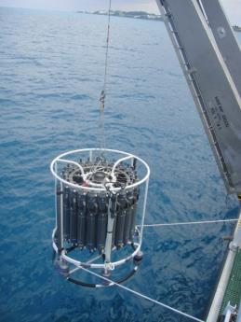
The CTD Rosette
At points along the route, the ship will stop, and a CTD instrument will be lowered into the water.
CTD stands for Conductivity, Temperature, and Depth
It has severals bottles to collect water samples at different depths as it descends.
It can take several hours to reach the deepest parts of the Atlantic and return to the surface.
Animation of how a CTD works: https://www.youtube.com/watch?v=JOuJt4_TRP0
Notes:
Nice animation of the CTD launch process (created by an Australian research institute, CSIRO):
https://www.youtube.com/watch?v=JOuJt4_TRP0

Slide 25
How deep is 4000m?
4000m is very deep.
How long would it take you to walk 4000m – or 4 km - on foot?
If all the children in your class stood on each other’s shoulders, how many classes would it take to reach 4000m?
Notes:
Some ideas to put the depth of the ocean into context
Google maps estimates 4km to take about 50 minutes on foot (average adult walking pace, I’m guessing)
A class of 30 average height 10 year olds (at 138.4cm) would add up to 41.32 metres, so you’d need to stack about 97 classes on top of each other!
You could do this with real heights of children – perhaps by class or by school – and share your numbers.

Slide 26
Activities with Schools
Outreach

Slide 27
Outreach activities
During the cruise, we hope to carry out the following:
Miniboats
Video/photo of final preparations
Video/photo of launching
Video calls
With the four schools (if possible, livestream so non-participants can watch)
Dates and times available to set calls with each school
Answer questions from the students
Blog posts
Trainees’ testimonials
Series “10 questions for…” (science and crew)
Social media
Photo of the day

Slide 28
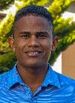
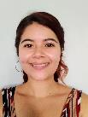
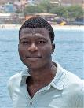
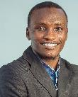
Who are the trainees?
13 students; 13 Countries represented
Argentina, Bangladesh, Benin, Colombia, Egypt, Germany, India, Mexico, Nigeria, Peru, Philippines, South Africa & Spain
Will receive training in
Physics of the climate: processes and models
Physical, chemical and biological oceanography
Microbiology
Bathymetry
Science communication
Notes:
These are some of the faces you might see when your school video-calls with the ship!

Slide 29
Other people you might speak to:
Dr Angelica Dummermuth
Alfred Wegener Institute
Mrs Fiona Beckman POGO
Professor Karen Wiltshire Alfred Wegener Institute
Dr Eva Brodte Alfred Wegener Institute
Dr Lilian Krug POGO
Ms Cassie Stymiest Educational Passages
Dr Maité Guignard Alfred Wegener Institute
On board or On land
Notes:
These are the main people who will be talking to you and your teachers – either from land, or from the Ship.

Slide 30
What will you ask?
Why do we need to measure the ocean’s temperature?
What are phytoplankton and why they are important?
Why are the oceans salty?
Why do we need to protect the ocean?
What’s the best thing I could do to help the climate?
What is life like on board the ship?
Notes:
We’re sure you will have lots of questions when we Skype with the school, but here are a few ideas to get you started.
Please write down your question ideas and send them to us, so we can make sure the right expert is available to talk to you.
If we don’t have time to answer all the questions on the Skype call, we will send email or video responses.

Slide 31
What else can you do?
Follow Polarstern’s location – and plot on a map
Follow the miniboats after deployment
Interact with other project schools

Slide 32
More online:
Ocean Training Partnership web page:
http://www.oceantrainingpartnership.org/outreach
Educational Passages:
https://educationalpassages.org/
Social media tags:
Hashtags → #NoSoAT , #PS132, #Polarstern, #miniboats, #oceandecade, #UNOD
Tag → @awi_media, @pogo_ocean, @ocean_training, @NipponZaidan, @miniboats

Slide 33
Lica: lakrug@ualg.pt
Fiona: fbe@pml.ac.uk

