Slide 1
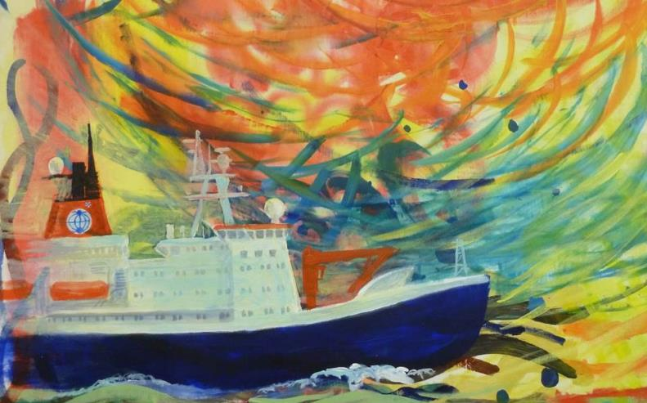
The South-North Atlantic Training Transect
A Scientific Research Expedition to observe the ocean

Slide 2
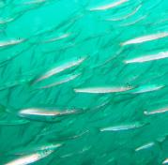
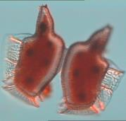
Some Facts and Figures about the Ocean
The ocean covers 70% of the surface of the Earth
The ocean represents over 90% of the Earth’s biosphere
Phytoplankton in the ocean produce as much oxygen as land plants
Notes:
It is often said that we know more about the dark side of the Moon than we do about the ocean. However, the ocean plays a vital role for us all.
3 key examples are:
(1) the ocean covers more than 70% of the surface of the Earth;
(2) the ocean represents more than 90% of the Earth’s biosphere (the space in which living organisms can exist);
(3) perhaps the least well known but most important element, microscopic plants (phytoplankton) in the ocean produce as much oxygen globally as land plants, providing half the oxygen we breathe.

Slide 3
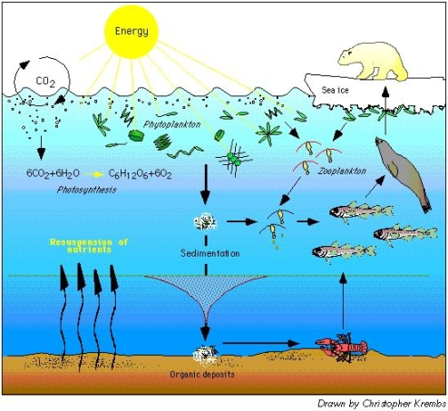
The importance of phytoplankton
phytoplankton
zooplankton
photosynthesis
resuspension of nutrients
sedimentation
Organic deposits
Notes:
This diagram shows some of the important processes that take place in the ocean, such as
draw down of CO2 from the atmosphere into the surface ocean,
uptake of CO2 by phytoplankton, which are at the base of the food chain.
Sinking of dead phytoplankton to the bottom of the ocean allowing carbon to be locked away for very long periods of time.
These are all very important mechanisms in the context of manmade CO2 emissions being taken up by the ocean.

Slide 4
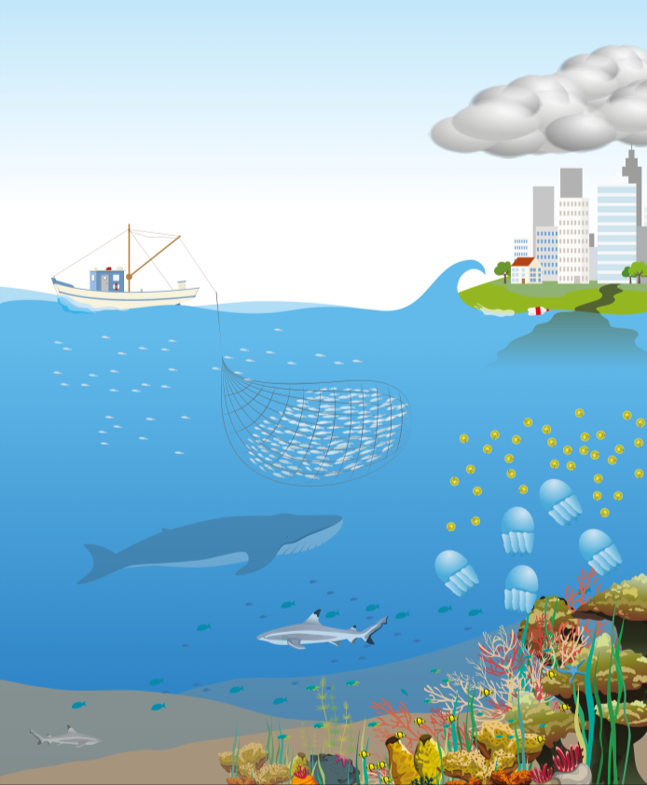
WHY do we need to observe the ocean?
Predict the weather
Understand the changing climate
Monitor pollution
Use the ocean’s resources responsibly
Monitor blooms
Notes:
Monitoring and exploring the ocean is very important so that we can understand and predict future changes.
Predict weather
People who live by the coast or sail on the ocean can be put in danger by severe storms, flood and droughts. Weather forecasting helps to keep them safe
Understand the changing climate
Climate change will cause rising sea levels, change to weather, changes to plants and animals, and erosion of land
Monitor pollution
Pollution such as plastics, litter, sewage, chemicals and noise can come from land or from ships and boats
Use the ocean’s resources responsibly
We use the ocean for food (fish, shellfish), minerals (metals, oil, salt) and energy (wind, waves)
Monitor blooms
When conditions are right, algae and sea jellies can grow and reproduce rapidly, causing a population explosion or bloom.
Some blooms can be toxic to fish or cause illnesses in humans.

Slide 5
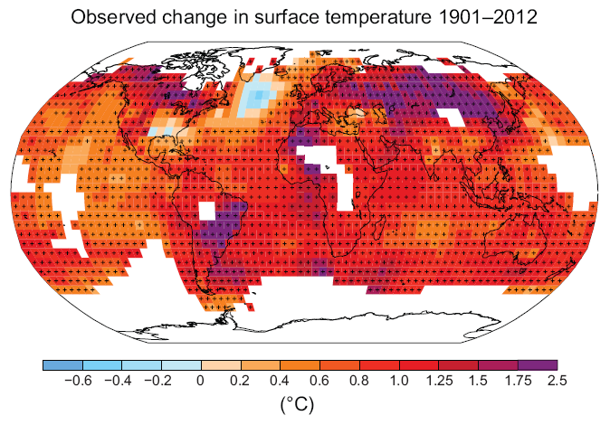
Ocean warming
IPCC, 2013: Summary for Policymakers.
IPCC AR5, Box 3.1 Fig1, Rhein et al. 2013
More than 90% of Earth’s heat increase has been absorbed by the ocean.
Notes:
The figure on the left shows that actually very little of the excess heat produced by CO2 emissions has been retained in the atmosphere or on land.
In fact, 90% of the Earth’s heat increase has been absorbed by the ocean, and this has taken place only in the last few decades.
It is important to note that a lot of the excess heat has already been taken into the deep ocean.
- The changes is ocean temperature (shown on right) are already affecting the global distribution of fish, invertebrates and plankton species.

Slide 6
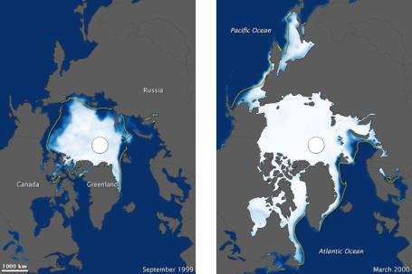
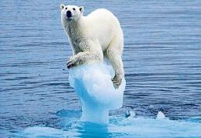
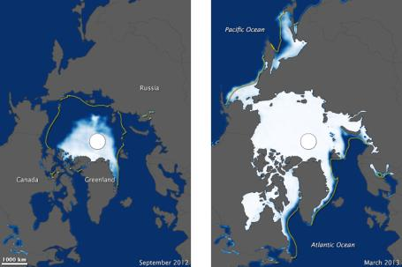
Melting ice
Sept 1999
Mar 2000
Over the last two decades, the Greenland and Antarctic ice sheets have been losing mass, glaciers, Arctic sea ice and snow cover have continued to shrink.
These satellite images show an overall decline in Arctic sea ice, particularly since 1999.
Source: telegraph.co.uk
Sept 2012
Mar 2013
Source: NASA Earth Observatory, http://earthobservatory.nasa.gov
Notes:
- These satellite images from NASA show the Arctic ice cover during summer (on left) and winter (on right),
- There has been an overall decline since 1978, but particularly since the turn of the 21st century.
- We are observing very recent and rapid changes.
Among other impacts, this will affect animals that rely on the ice for their survival.

Slide 7
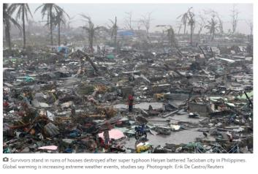
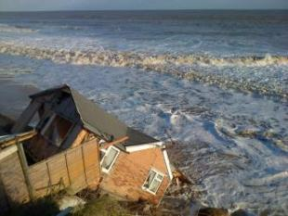
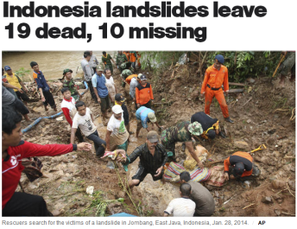
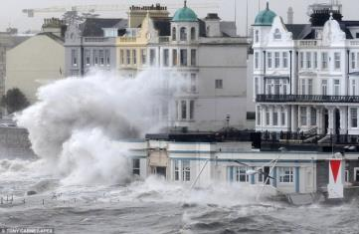
More extreme weather events
UK: Worst storm and tidal surge in 60 years , 2014
Typhoon Haiyan in the Philippines, 2013
Source: theGuardian.com
Source: DailyMail.uk
Notes:
- It is predicted that a rise in extreme weather events will be associated with the higher temperatures and precipitation in future.
Recent examples of this trend include the “super typhoon” Haiyan in the Philippines.
Closer to home there were severe storms/tidal surges in the UK earlier this year that caused flooding, cliff erosion and loss of properties, and destruction of train lines along the coast.
Heavy precipitation is also causing landslides causing major destruction and loss of life (example Indonesia this year).

Slide 8
WHAT do we measure?
Notes:
We measure lots of different properties of the ocean, from the temperature and colour of the water, to the amount of animals living in a particular area.
There are some very technical terms here, but I bet you know some of them.
You could ask the scientists on Polarstern about any you don’t understand.

Slide 9
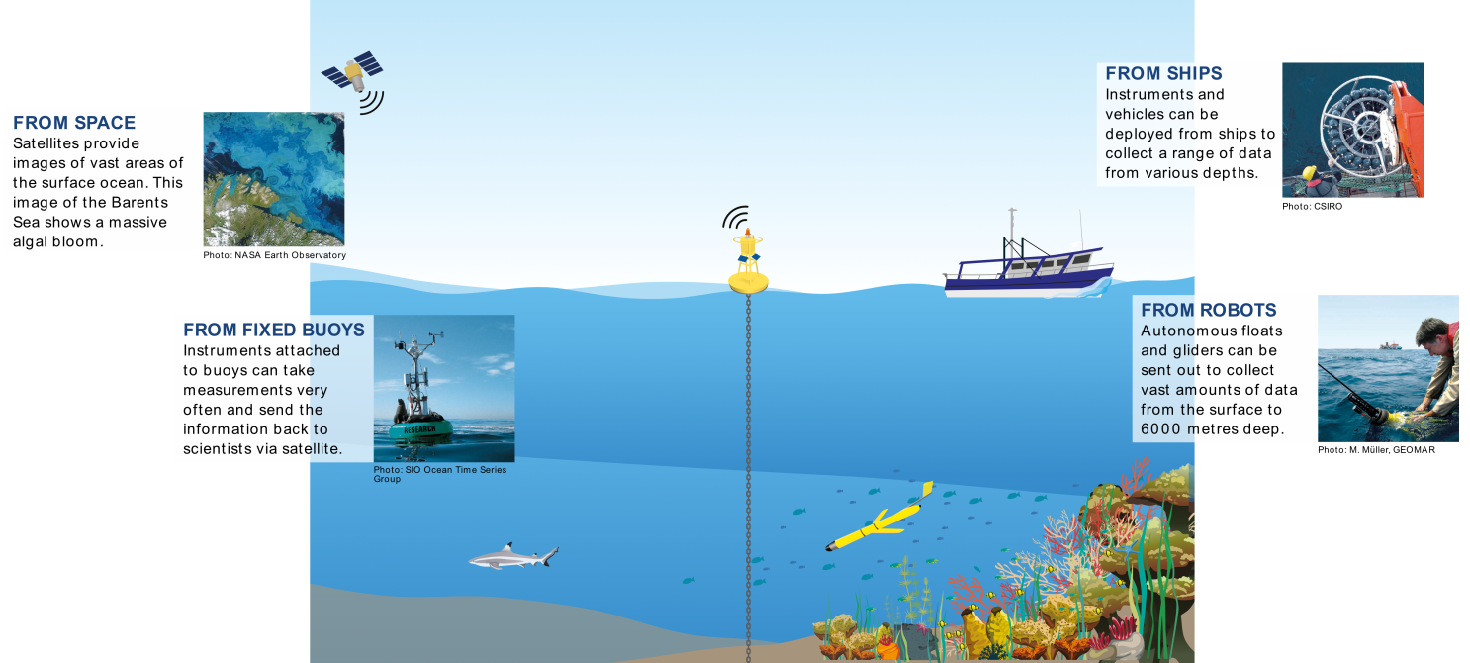
HOW do we observe the ocean?
Notes:
Scientists use different methods and equipment to observe and measure the ocean.
One important way to is to travel across the ocean on a research ship, taking lots of samples and measurements along the way, and trying to understand what the measurements mean.
This is what the SoNoAT project is all about. We will have 25 young marine scientists on board the ship, Polarstern, together with several expert teachers.
These young scientists may seem old to you! They are between 23 and 29 years old, but scientists never stop wanting to learn more about the subjects that interest them, so they are going school on board the ship!
They come from lots of different countries around the world – mainly Developing Countries, which are places that don’t have as much money for scientific research as countries in Europe or North America They will learn lots about ocean observing while on board the ship, and then take this knowledge back home to their own universities and research institutions.

Slide 10
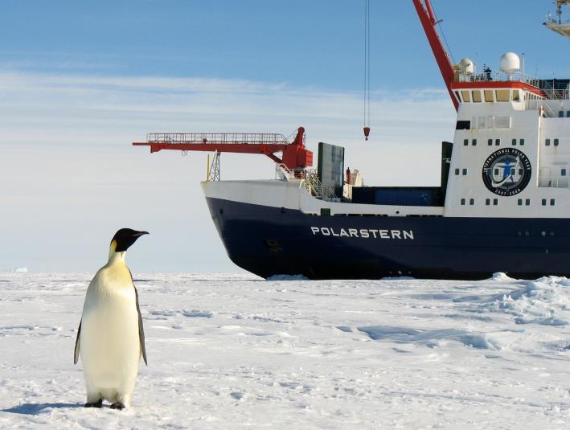
The Ship: R/V Polarstern
German research ship
An ‘Icebreaker’ that mainly works in the ARCTIC and ANTARCTIC
118 metres long
44 crew + 55 scientists
2 helicopters on board
Notes:
This is the Polarstern, which is the ship the scientists will be travelling on in June.
R/V stands for Research Vessel.
It takes a crew of 44 people to run the ship.
As well as this, up to 55 scientists and technicians can live and work on board.
The ship has nine science laboratories.
More about the ship:
https://www.awi.de/en/expedition/ships/polarstern/the-symbol-of-german-polar-research.html

Slide 11
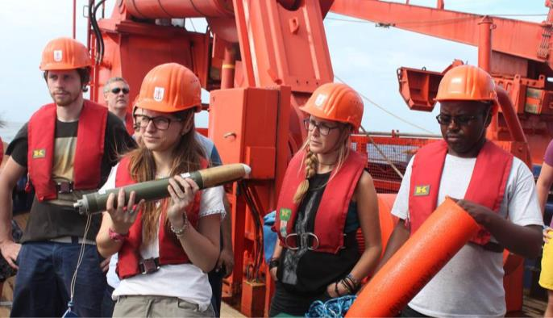
In one month at sea…
Polarstern’s engines and boiler burn 900 tonnes of diesel fuel
The ship’s galley (kitchen) bakes 3,150 rolls
In the mess hall (dining area) 3,200 eggs, 360 litres of milk and 180 litres of fruit juices are consumed
The people on board use 680 rolls of toilet paper
Notes:
Taking a research ship on an ocean expedition costs a lot of money, and takes lots of organising.
Here are just a few of the things the people planning the cruise need to think about.

Slide 12
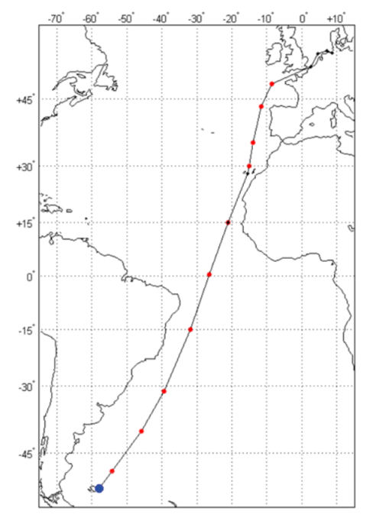
Where will it go?
Leaves:
Port Stanley, Falkland Islands
on 3 June
Travels north
Arrives:
Bremerhaven, Germany
on 29 June
Notes:
This is simple map showing the route the ship will take.
They will leave Port Stanley, in the Falkland Islands, on 3 June.
They will stop to refuel and restock in the Canary Islands on 20 June.
They will then travel the rest of the way to Polarstern’s Home Port, at Bremehaven in Germany. They will arrive on 29 June.
The red dots show CTD sampling stations. These are places where instruments are sent deep into the ocean to collect samples.

Slide 13
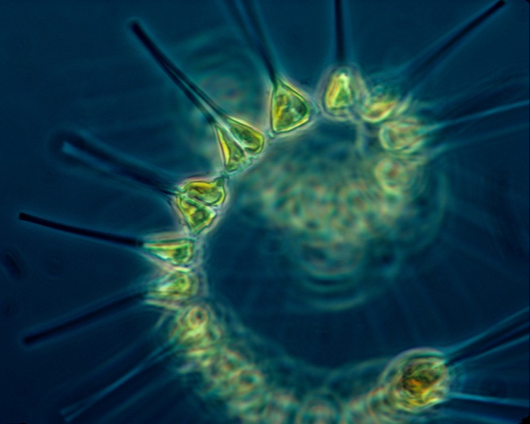
What will they be studying?
Water temperature and other physical properties
Plastics and micro-plastics
Phytoplankton (tiny floating plants)
eDNA (environmental DNA in the water can tell us about different plants and animals)
Notes:
The scientists will be studying lots of topics during the expedition, but they are particularly interested in how the ocean and climate interact with each other.
They will also be looking at plastic pollution in the Atlantic.

Slide 14
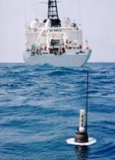
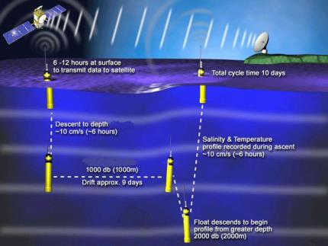
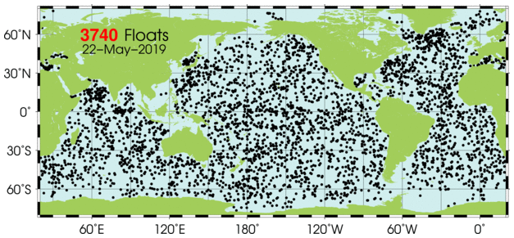
ARGO floats
The Polarstern will deploy four ARGO floats along the route
These are instruments which drift with the ocean currents, taking measurements
Automatically dive to 2000m
Once at the surface it transmits location and recordings by satellite to Argo data centers
Since the year 2000, over 3,700 Argo floats have been deployed around the world
Watch this video to find out more: https://www.youtube.com/watch?v=WGbanFvBX38
Source: Ifremer/ Coriolis
Source: GOOS
Source: http://www.argo.ucsd.edu
Notes:
During the cruise, the ship will put four new ARGO floats into the ocean.
Please watch this excellent (Australian) animation about measuring the ocean, and how Argo floats work (linked in the slide above). It’s pitched really well at Primary aged children.
https://www.youtube.com/watch?v=WGbanFvBX38
You can also see a short video about Argo here, with footage from ships:
https://www.youtube.com/watch?v=Xw9Vzbo8LfE
And here is a short BBC video about ARGO floats
https://www.youtube.com/watch?v=JTH7PyR3buA

Slide 15
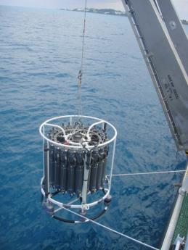
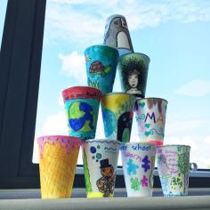
The CTD Rosette
At points along the route, the ship will stop, and a CTD instrument will be lowered into the water.
CTD stands for Conductivity, Temperature, and Depth
It has severals bottles to collect water samples at different depths as it descends.
It can take several hours to reach the deepest parts of the Atlantic and return to the surface.
Your school’s decorated cups will be attached to the CTD, and sent 4000 metres down!
Animation of how a CTD works: https://www.youtube.com/watch?v=JOuJt4_TRP0
Notes:
Nice animation of the CTD launch process (created by an Australian research institute, CSIRO):
https://www.youtube.com/watch?v=JOuJt4_TRP0

Slide 16
How deep is 4000m?
4000m is very deep.
How long would it take you to walk 4000m – or 4 km - on foot?
If all the children in your class stood on each other’s shoulders, how many classes would it take to reach 4000m?
Notes:
Some ideas to put the depth of the ocean into context
Google maps estimates 4km to take about 50 minutes on foot (average adult walking pace, I’m guessing)
A class of 30 average height 10 year olds (at 138.4cm) would add up to 41.32 metres, so you’d need to stack about 97 classes on top of each other!
You could do this with real heights of children – perhaps by class or by school – and share your numbers.

Slide 17
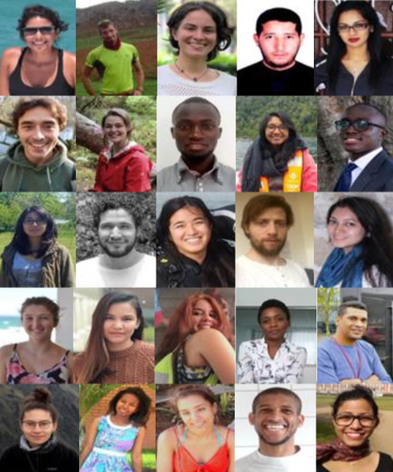
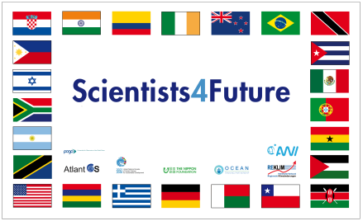
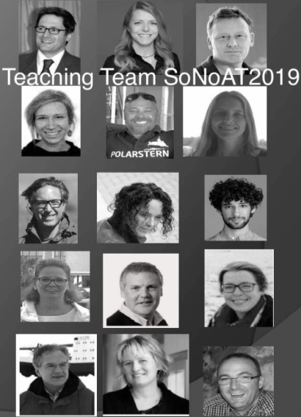
Who are the scientists?
25 students; 15 teachers
26 Countries represented
Argentina, Bangladesh, Brazil, Chile, Colombia, Croatia, Cuba, Germany, Ghana, Greece, India, Ireland, Israel, Kenya, Madagascar, Mauritius, Mexico, New Zealand, Palestine, Philippines, Portugal, Senegal, South Africa, Tanzania, Trinidad & Tobago, and the USA
Notes:
These are some of the faces you might see when your school video-calls with the ship!
The ‘Scientists4Future’ banner with all the country flags, will be proudly displayed on the ship

Slide 18
What will you ask?
Why do we need to measure the ocean’s temperature?
What are phytoplankton and why they are important?
Why are the oceans salty?
Why do we need to protect the ocean?
What’s the best thing I could do to help the climate?
What is life like on board the ship?
Notes:
We’re sure you will have lots of questions when we Skype with the school, but here are a few ideas to get you started.
Please write down your question ideas and send them to us, so we can make sure the right expert is available to talk to you.
If we don’t have time to answer all the questions on the Skype call, we will send email or video responses.

Slide 19
People you might speak to:
Dr Sophie Seeyave POGO
Mrs Fiona Beckman POGO
Professor Karen Wiltshire Alfred Wegener Institute
Dr Eva Brodte Alfred Wegener Institute
Dr Lilian Krug POGO
Notes:
These are the main people who will be talking to you and your teachers – either in person in Plymouth, or on the Skype call with the Ship.

